Slide 1
Queues
First in First out subset of a link list

Slide 2
Queue: Data Structures
What is a queue?
head of queue
tail of queue
A queue is used in many places in operating systems: e.g. process, virtual memory, input/output operations
It’s a structure that conforms to the principle of First In, First Out (FIFO).
The first item to join the queue is the first item to be served.

Slide 3
The queue
The queue, like the link list and stack, is comprised of nodes.
It uses two functions which, by convention, are referred to as:
enqueue (add node to end of queue)
dequeue (remove node from head of queue)
It has the constraint of not removing a node from an empty queue.

Slide 4
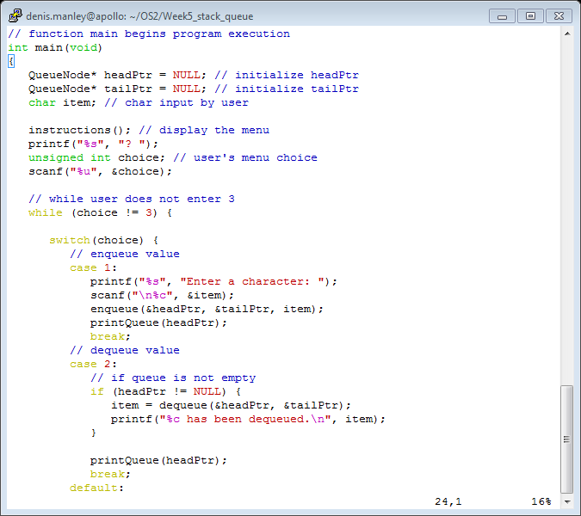
Function Main

Slide 5
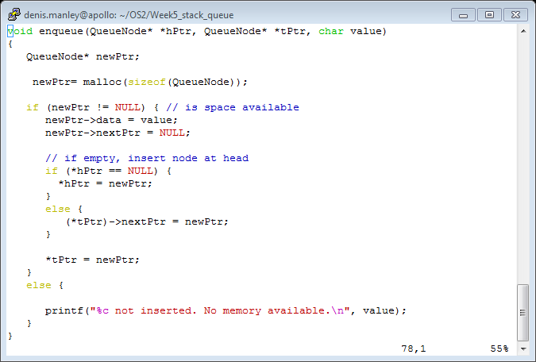
Enqueue function

Slide 6
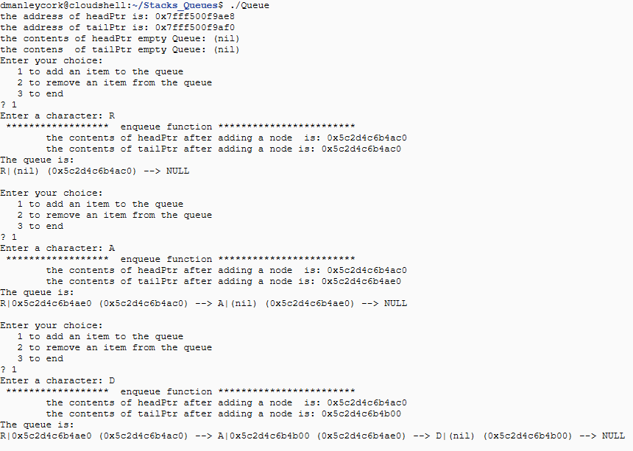
Enqueue 3 nodes: Queue.c
Illustrate add node N address 4b20 to this queue

Slide 7
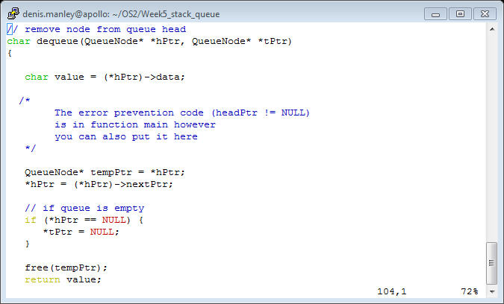
Sample dequeue code

Slide 8
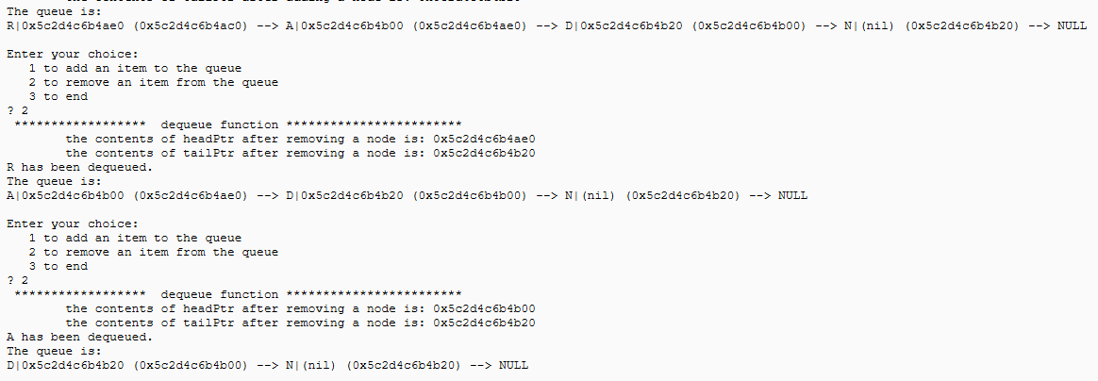
Dequeue 2 nodes: Queue.c
4 nodes in Queue. Sample output Deleted (Dequeued) two nodes.

Slide 9
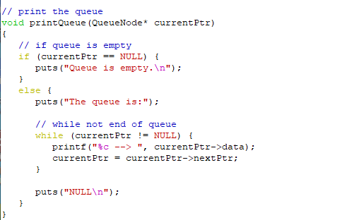
Print Function
Why is currentPtr a “single” pointer to a node; What does it store?

Slide 10
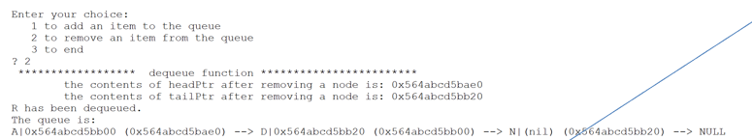
Class Question Illustrate the variables in Print Queue
Given a queue with 3 nodes (refer to slide enqueue to non empty queue) Illustrate:
show the changes to currentPtr as the list is printed.

Slide 11
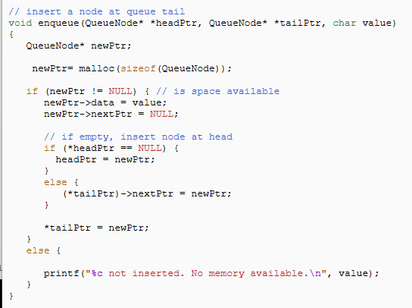
Why does a missing * cause erratic behaviour
Issue with code is here.

Slide 12
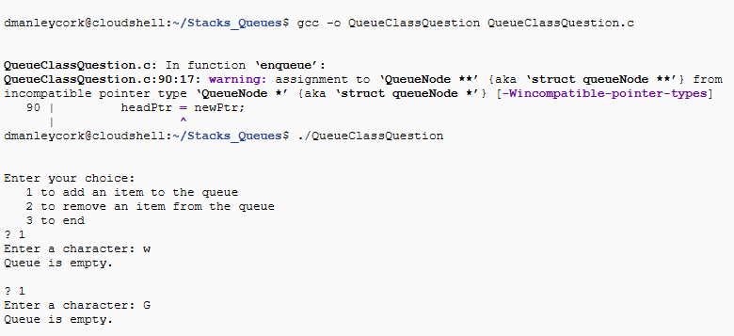
Explain why it results below
Compiling the code gives the following warning and execution of code in previous slide: only showing enqueue function

Slide 13
Lab/Class Questions
Hint:
A warning is not the same as an error. A program will run with a warning but:
may not behave as expected.
Cause segmentation fault is often the result in trying to access a memory location that does not exist.

Slide 14
Sample Questions
Describe, using examples, what is a queue data structure and give two examples of where it may used in operating systems.

Slide 15
Sample question
Explain, using examples (include node addresses), how to enqueue and dequeue nodes from of a queue (10 marks)
Explain, using examples (include node addresses), how to push and pop functions of a stack (10 marks)

Slide 16
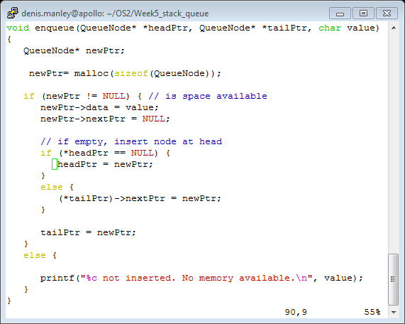
Explain if following “enqueue” function will correctly add (enqueue) nodes to a queue (10 marks)

Slide 17
Explain what the following code does and ìf it will successfully remove nodes from queue (10 marks)
char dequeue(QueueNode** headPtr, QueueNode** tailPtr)
{
if (*headPtr != NULL){
char value = (*headPtr)->data;
QueueNode* tempPtr = headPtr;
headPtr = (*headPtr)->nextPtr;
if (*headPtr == NULL) {
tailPtr = NULL;
}
free(tempPtr);
return value;
}
Else
Printf(“bla bla bla….”);
}

Slide 18
Illustrate output
Illustrate the expected output if you run the above programs: if the Queue has 3 nodes; (5 marks)
If the code is empty and/or the code is not empty (5 marks)

